Slide 1
SPEECH EMOTION RECOGNITION
MS.R.L.JASMINE JOSIKA P
Teaching Fellow 2019202020
MCA-R

Slide 2
MOTIVATION
Speech is a rich form to express emotions.
To find emotions using the vocal tones.
Deep Learning method to be used.
OBJECTIVE
Using CNN to find emotions.
Comparing 1D CNN and 2D CNN.
Total of 7 emotions to be found.

Slide 3
INTRODUCTION
This project aims at building and training speech and emotion recognization system
By using deep learning algorithm which uses CNN used for image/object recognization.
Previous work in this area included used machine learning algorithms.
As a result of less accuraccy we have compared the deep learning algorithms.

Slide 4
LITERATURE REVIEW
S.No. | Author name & Paper title | Concept in the paper (Algorithm, Advantages, Limitations, Future enhancement) | Paper details
1. | Speech Emotion Recognition using Deep Learning--Nithya Roopa S., Prabhakaran M, Betty. (2018) | It is used to find emotions through speech using IEMOCAP corpus Database the disadvantage is that it has low accuracy of 35.6% hence the accuracy could be enhanced | https://www.ijrte.org/wp-content/uploads/papers/v7i4s/E1917017519.pdf
2 | Convolution Neural Network for Speech Emotion Recognition--Shruti Garg, 2Gaurav Kumar | It uses Savee Dataset along with CNN model to predict emotions.The accuracy rate differs and does not work the same with other data sets and dataset contains only small files | https://www.ijcrt.org/papers/IJCRT2006076.pdf
3 | Speech Emotion Recognition using Neural Network and MLP Classifier--Jerry Joy, Aparna Kannan, Shreya Ram, S. Rama | It uses MLP algorithm to predict speech emotion .It has low accuracy of 58% while using MFCC .The model can be improved with CNN which is advanced to MLP. | https://ijesc.org/upload/17015f34daa6e925c92ce026adabfca9.Speech%20Emotion%20Recognition%20using%20Neural%20Network%20and%20MLP%20Classifier.pdf

Slide 5
DATASET DETAILS
Ryerson Audio-Visual Database of Emotional Speech and Song (RAVDESS)
RAVDESS contains 1440 files.
60 trials per actor x 24 actors = 1440.
Surrey Audio-Visual Expressed Emotion (SAVEE)
Savee contains 480 samples.
It contains 4 speakers with 7 emotions.

Slide 6
DATASET DETAILS
Toronto Emotional Speech Set(TESS)
There are 2800 data points (audio files) in total.
Spoken by two actresses (aged 26 and 64 years) with 7 emotions.
Crowd Sourced Emotional Multimodal Actors Dataset(CREMA-D)
CREMA-D is a data set of 7,442 original clips from 91 actors.
The sentences were presented using one of six different emotions and four different emotion levels .

Slide 7
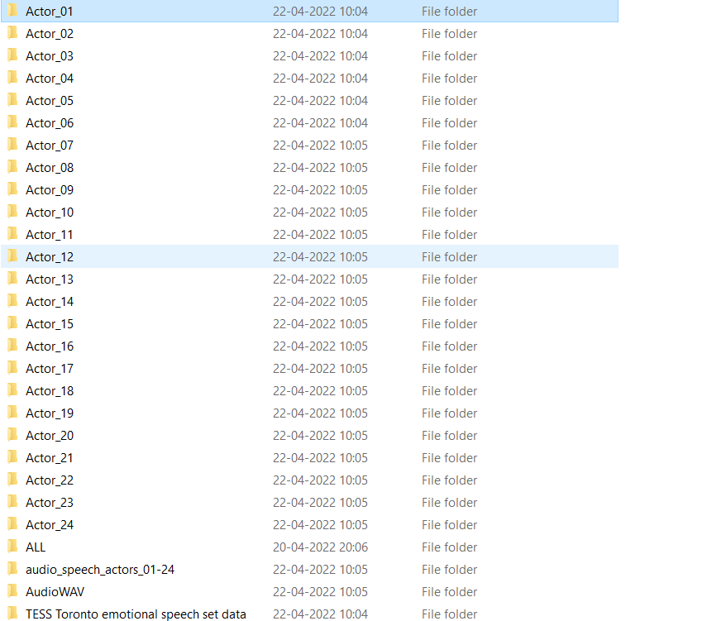

Slide 8
IMPLEMENTATION PLATFORM / FRAMEWORK
Platform –Jupyter Notebook
Language – Python3
Libraries – Librosa, Tensor flow
Model-CNN

Slide 9
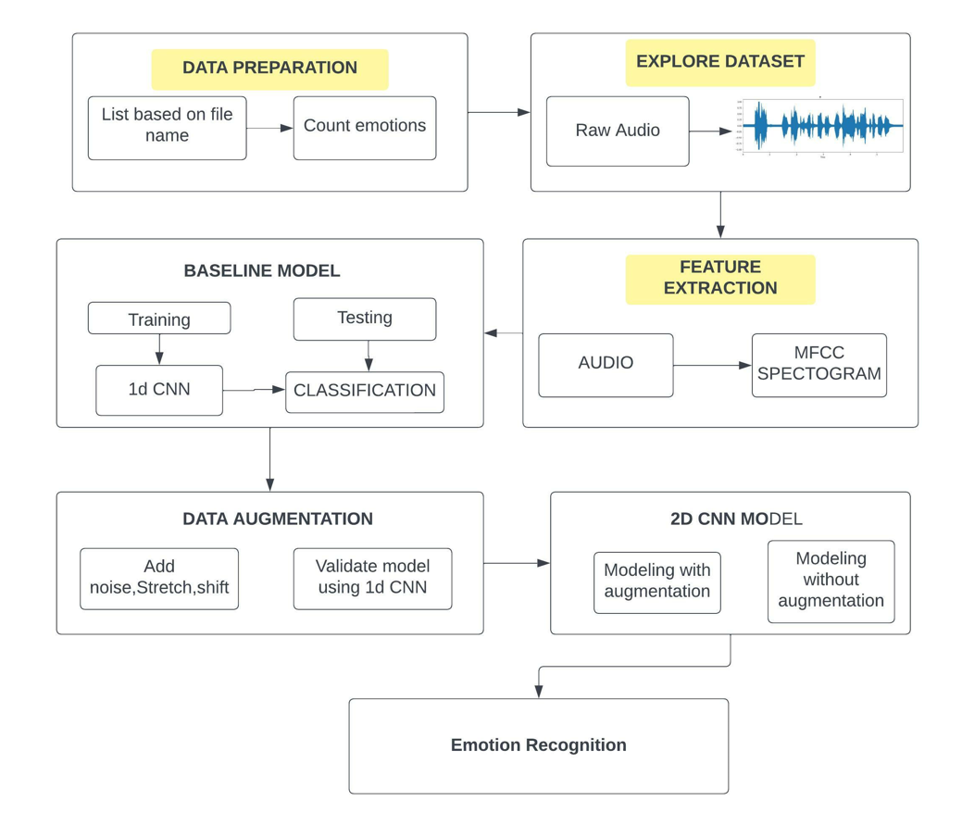
OVERALL ARCHITECTURE

Slide 10
LIST OF MODULES
1)Data Preparation
2)Explore Dataset
3)Feature Extraction
4)Baseline Model
5)Data Augmentation
6)2D CNN Classification model

Slide 11
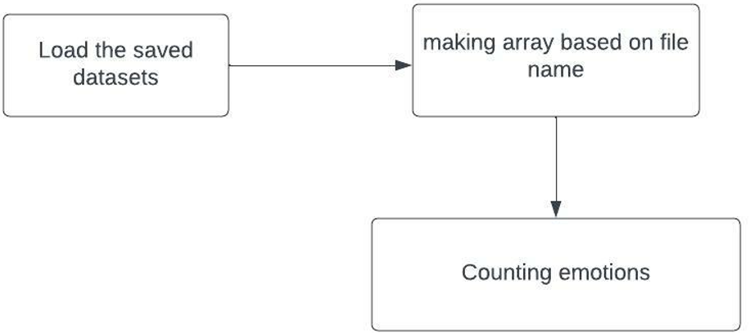
DATA PREPARATION
Description:
Here we are about to load the 4 different datasets from kaggle which contain audio files and count the emotions based on gender.

Slide 12
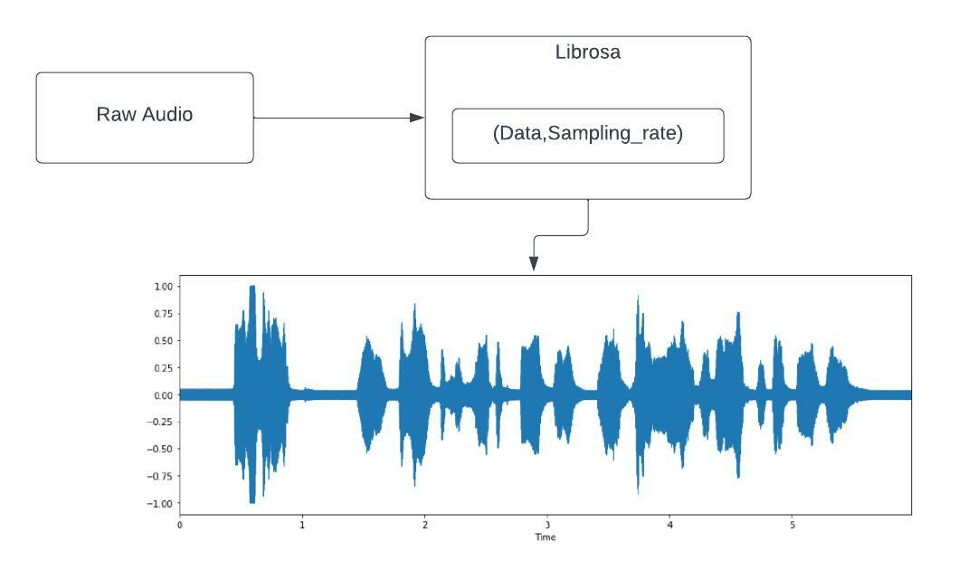
Explore Datasets
Description:
Here we will explore the audio files and plot them based on time and amplitude to check the fluxations based on different emotions and different genders.

Slide 13
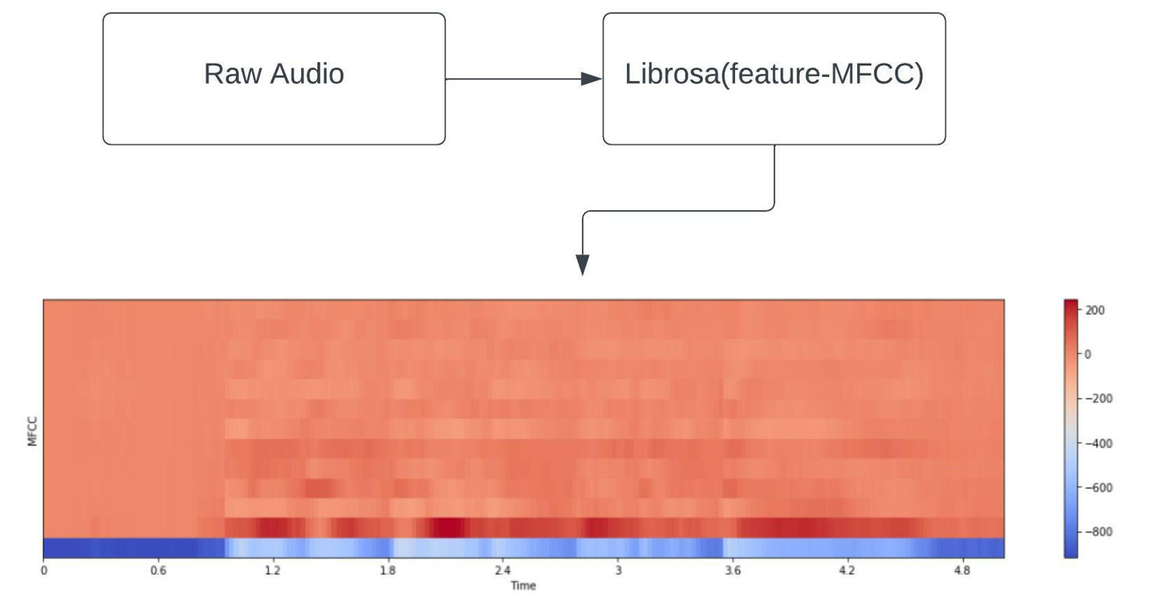
Acoustic Feature Extraction
Description
In this feature extraction part we
are going to use the fast fourier transform,melscale filter bank and
plot the MFCC bands with respect to time

Slide 14
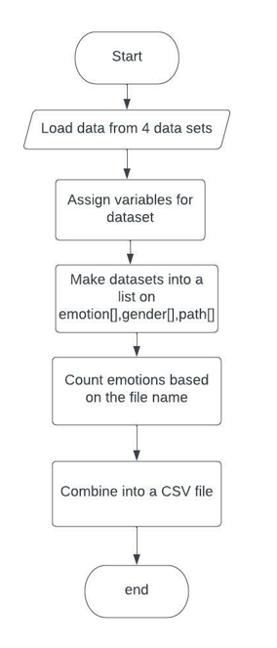
Data Preparation flow

Slide 15
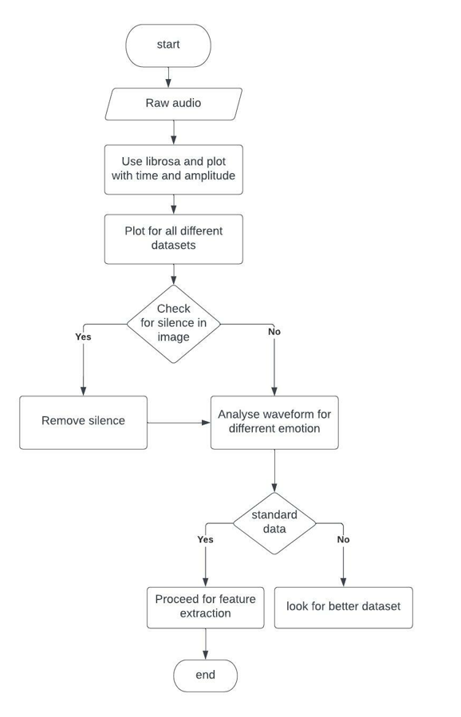
Explore Datasets flow

Slide 16
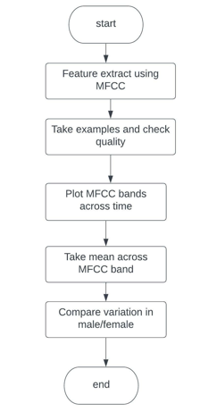
Feature Extraction Flow

Slide 17
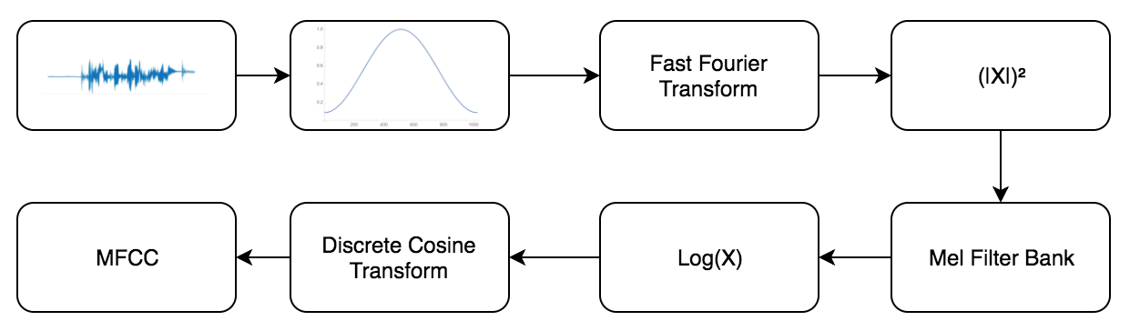
MFCC Flow

Slide 18
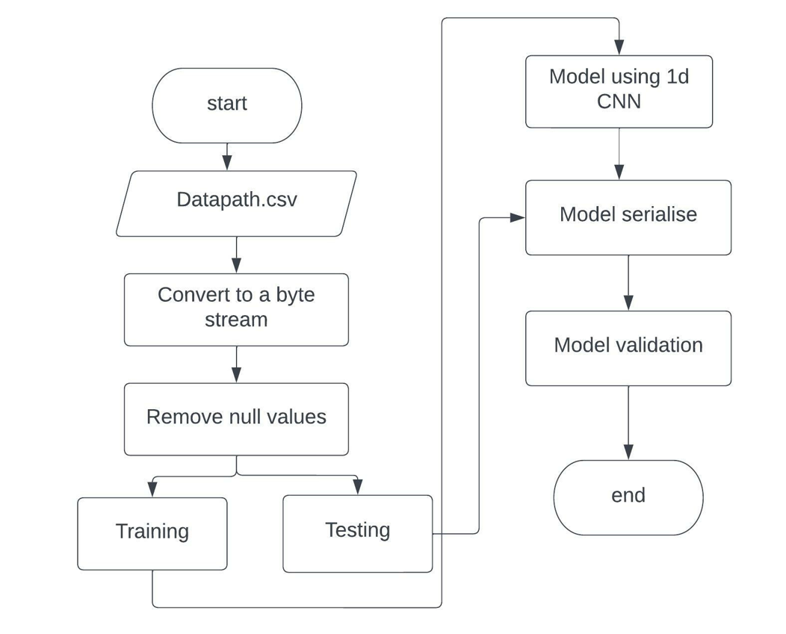
Baseline model flow

Slide 19
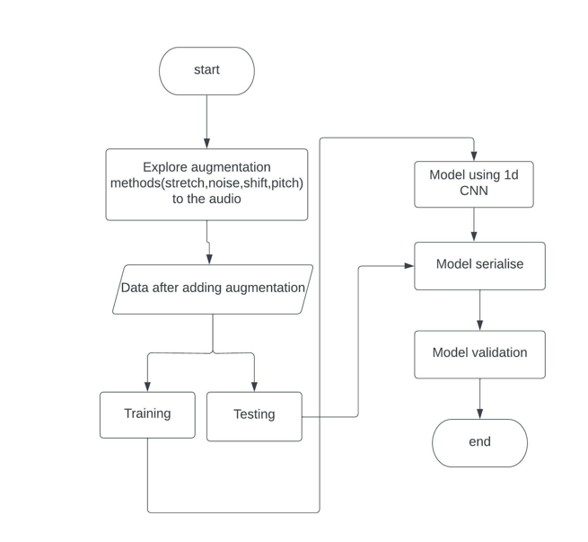
Data Augmentation Flow

Slide 20
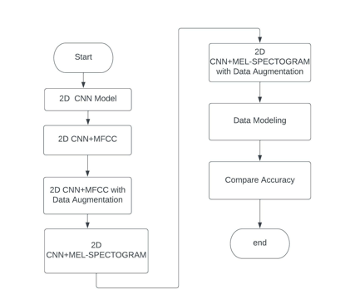
2D CNN flow

Slide 21
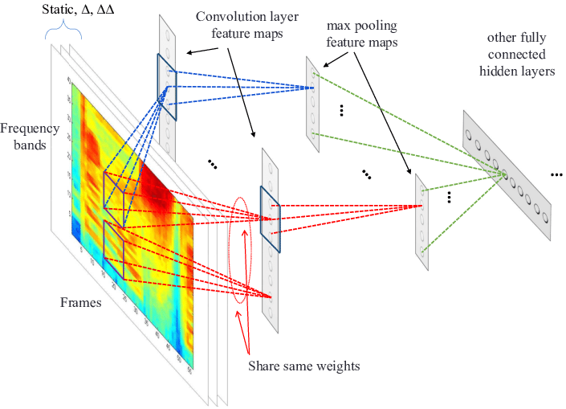

Slide 22
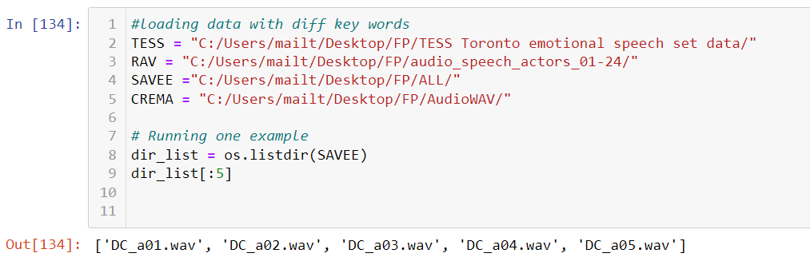
EXPLORE DATASET OUTPUT SCREENSHOTS

Slide 23
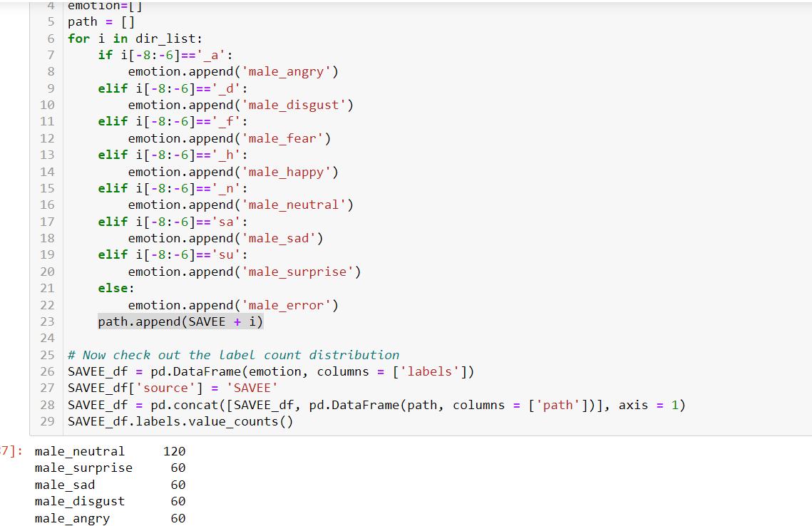

Slide 24
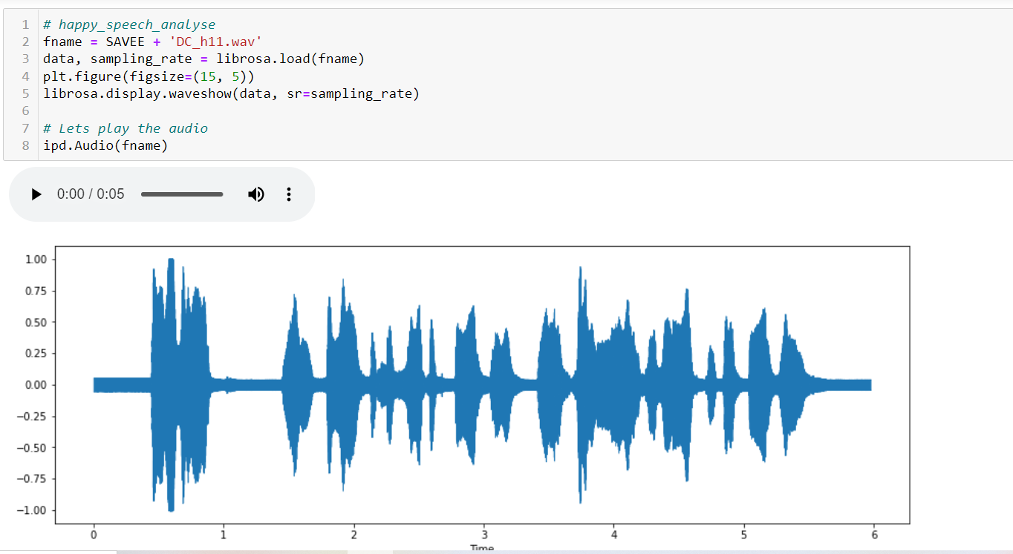

Slide 25
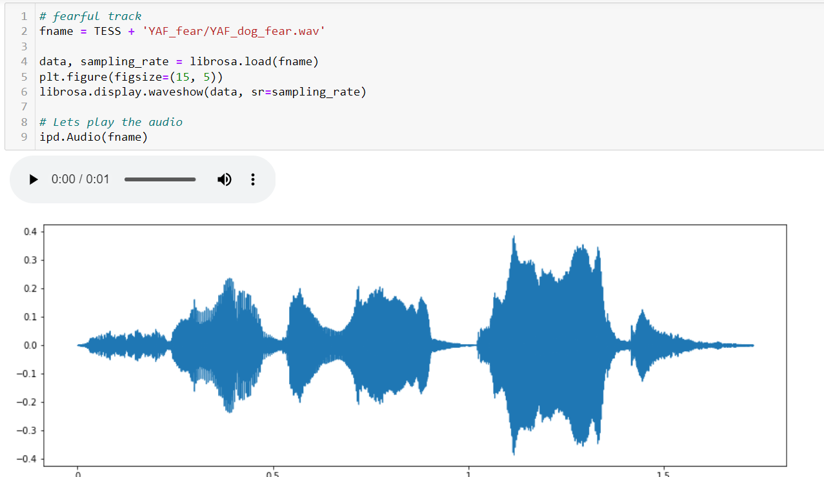

Slide 26
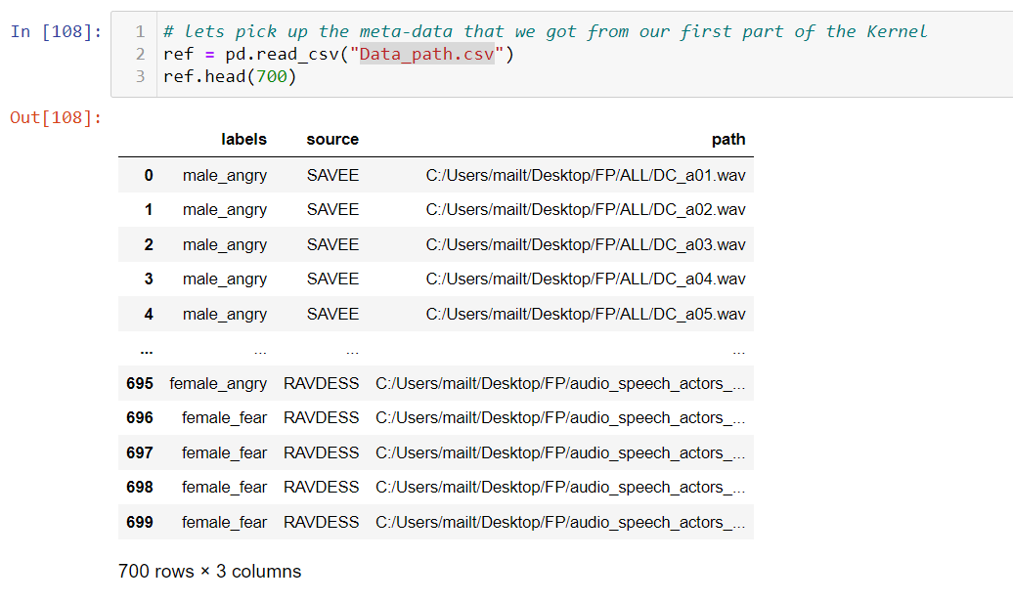
FEATURE EXTRACT OUTPUT SCREENSHOTS

Slide 27
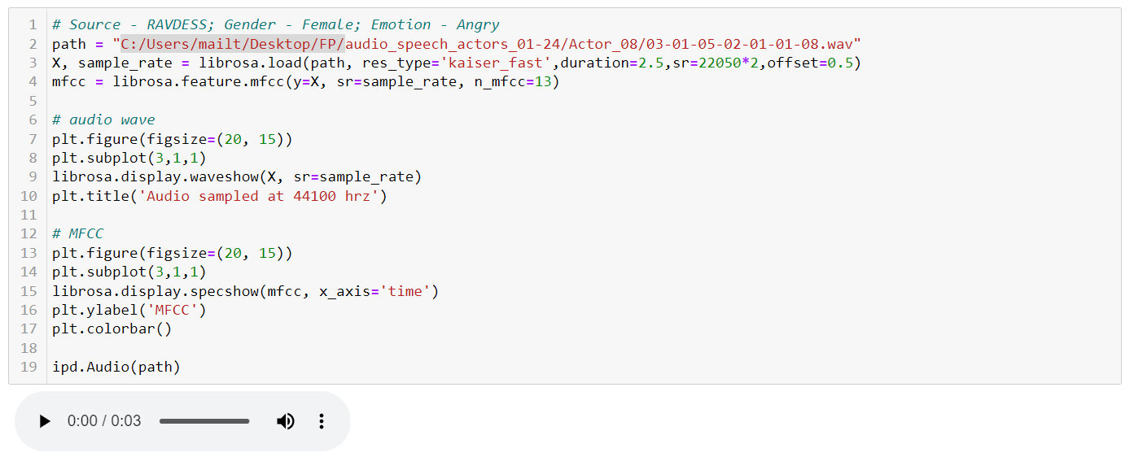

Slide 28
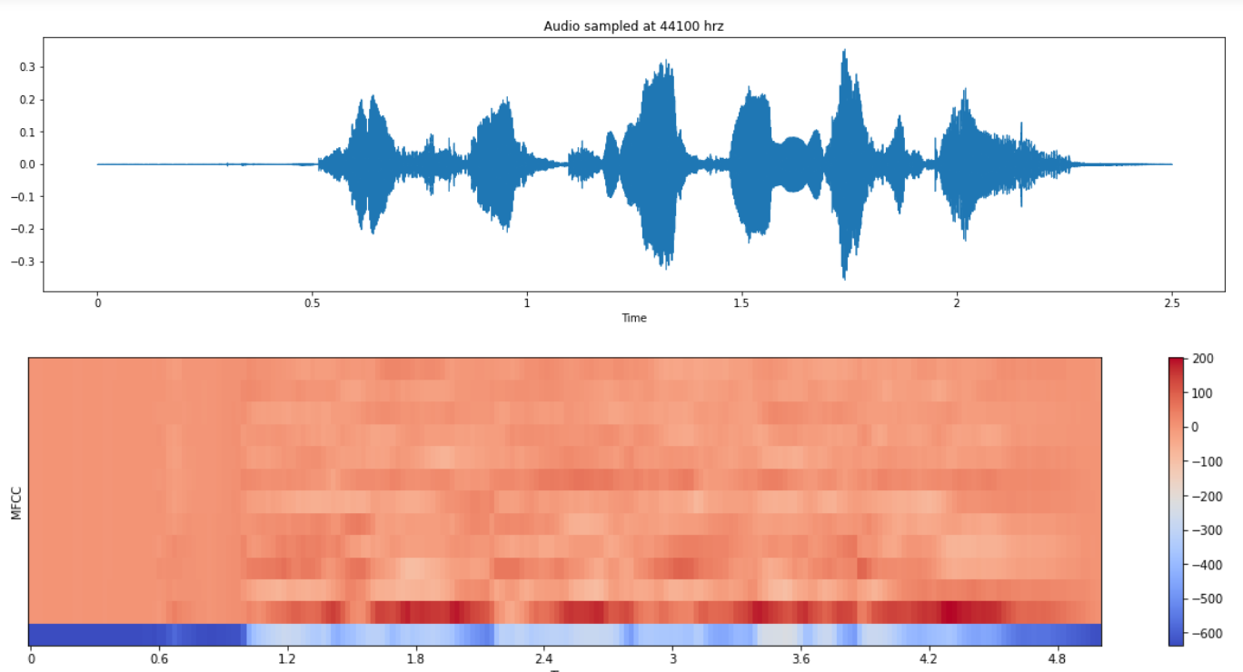

Slide 29
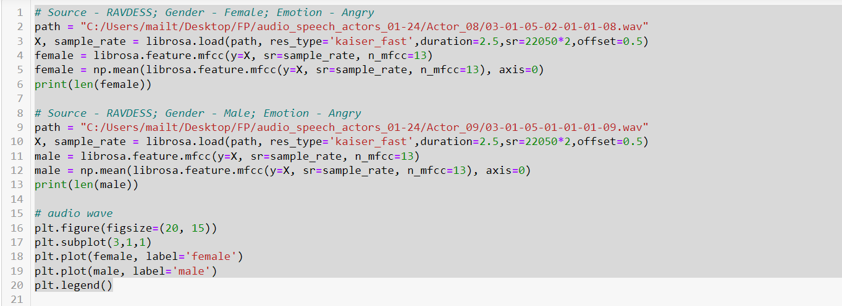

Slide 30
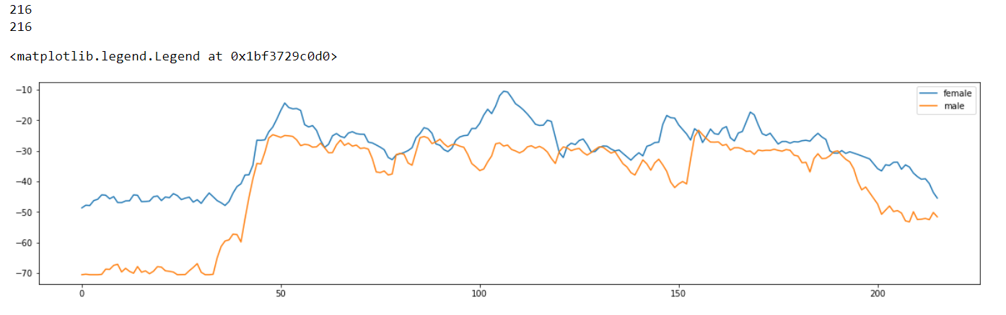

Slide 31
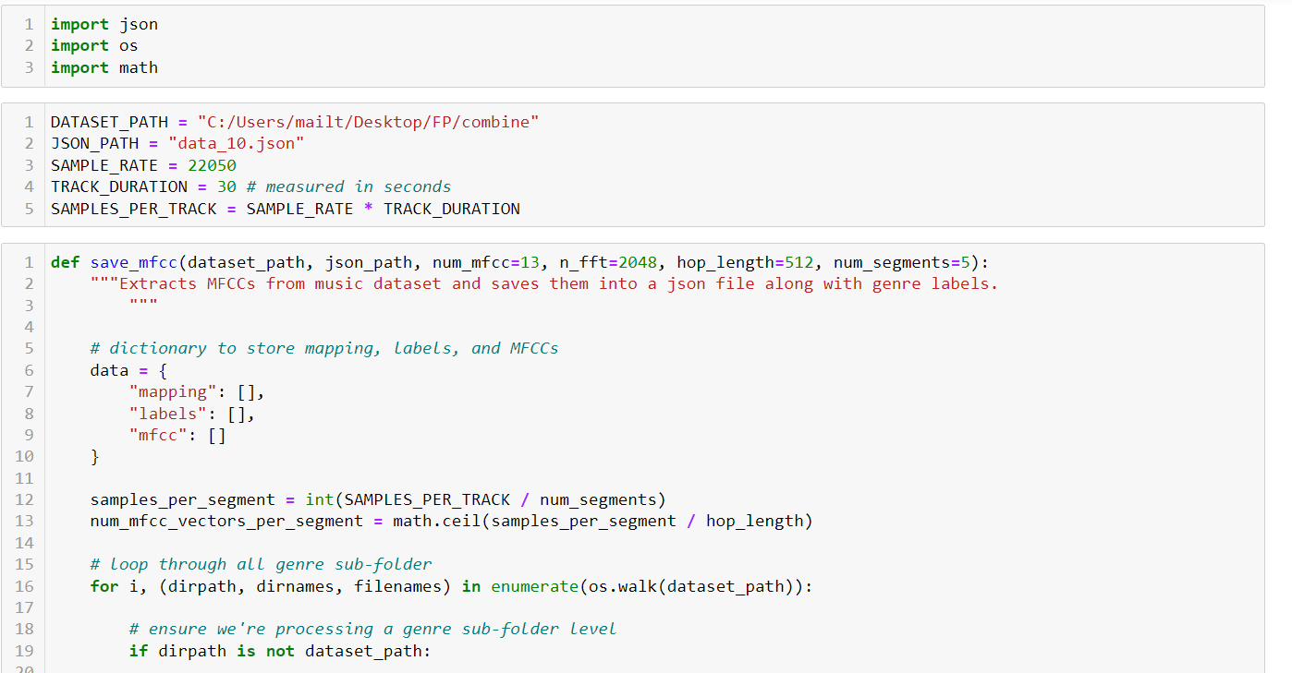

Slide 32
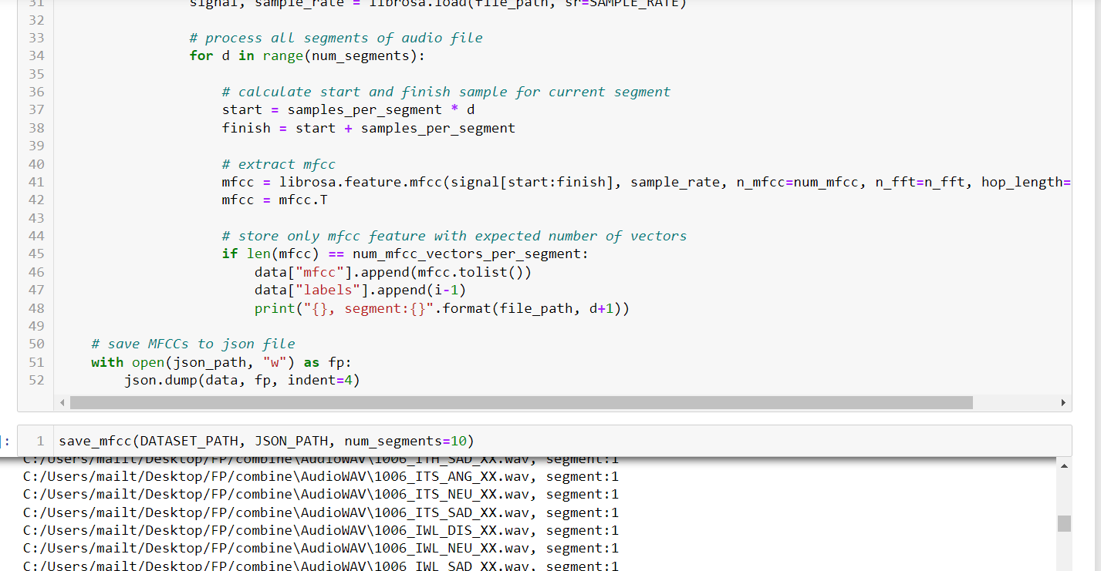

Slide 33
REFERENCES
1.Y. Chen, Z. Lin, X. Zhao, S. Member, G. Wang, and Y. Gu, “Deep Learning-Based Classi fi cation of Hyperspectral Data,” pp. 1–14, 2014.
2.L. Chua and T. Roska, “The CNN Paradigm,” vol. 4, no. 9208, pp. 147–156, 1993.
3.X. Xu, J. Deng, E. Coutinho, C. Wu, and L. Zhao, “Connecting Subspace Learning and Extreme Learning Machine in Speech Emotion Recognition,” IEEE, vol. XX, no. XX, pp. 1–13, 2018.
4.Z. Huang, J. Epps, D. Joachim, and V. Sethu, “Natural Language Processing Methods for Acoustic and Landmark Event-based Features in Speech-based Depression Detection,” IEEE J. Sel. Top. Signal Process., vol. PP, no. c, p. 1, 2019.
5.P. S. Member, “Transfer Linear Subspace Learning for Cross-corpus Speech Emotion Recognition,” vol. X, no. X, pp. 1–12, 2017.

Slide 34
THANK YOU

